Slide 1
Revision for Atmospheric Chemistry
Jie Zhang
ASRC-Office ETEC 320I
jzhang35@albany.edu
03/01/2023

Slide 2
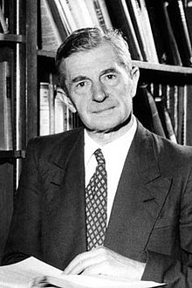
Chapman Mechanism for Ozone in the Upper Atmosphere (~1930)
1. Stratospheric ozone formation and loss
R1. O₂ + hγ → O + O; k₁ – photolysis (Production)
R2. O + O₂ + M → O₃ + M; k₂ – termolecular
R3. O₃ + hγ → O₂ + O(³P); k_{3a} – photolysis (Cycling)
→ O₂ + O(¹D); k_{3b} – photolysis
R4. O + O₃ → O₂ + O₂; k₄ – bimolecular (Loss)
[M] designates the total atmospheric gas concentration
slow
R2
O₂
R1
O O₃
fast
R3
R4
Sydney Chapman
(1888-1970)
slow

Slide 3
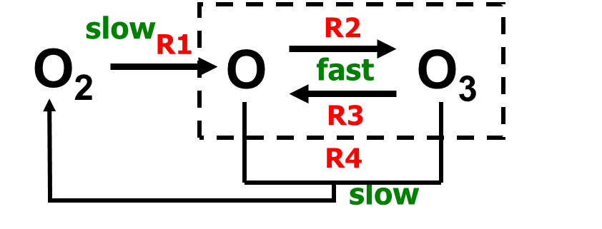
Enter Catalytic Reaction Cycles
1. Stratospheric ozone formation and loss
In a catalytic cycle there is no net effect on the catalytic species
Simplest examples look like
X + O₃ → XO + O₂
XO + O → X + O₂
NET: O + O₃ → 2O₂
But there is net loss of O_{x} (i.e., O₃)
Catalytic cycles reduce the ozone concentration
X in the above chemical equations (the catalyst) is a free radical like NO, OH, Cl, Br, etc.
*Free radicals are short-lived, highly reactive species that drive the chemistry they have one or more unpaired electrons

Slide 4
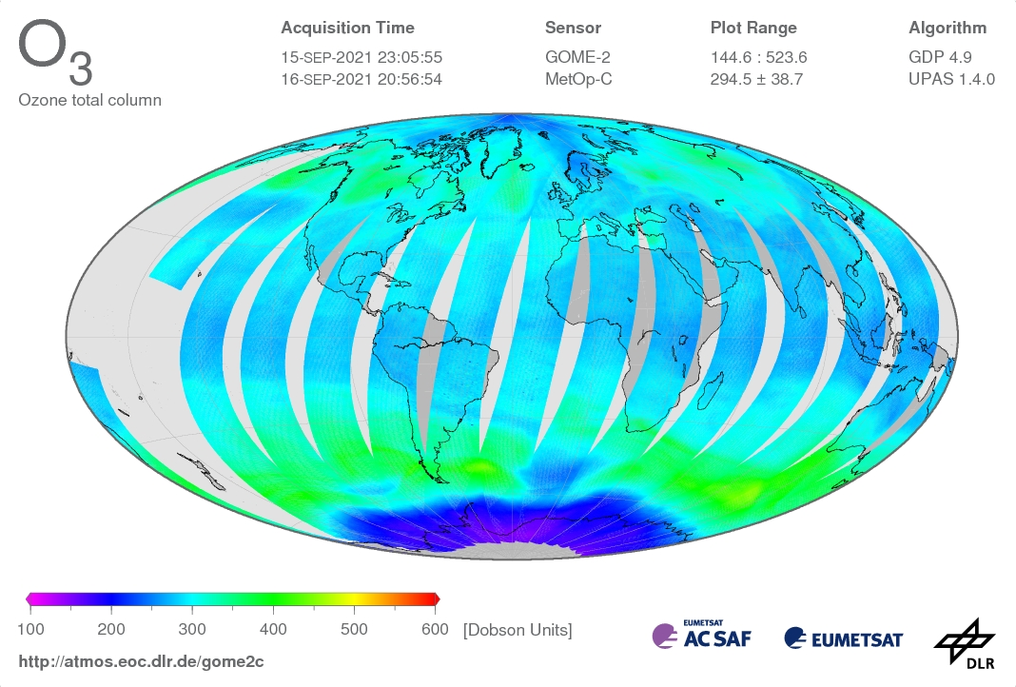
1. South Polar Ozone Loss
The Antarctic Ozone Hole was first reported in 1985.
This geographically (polar vortex region) and seasonally (austral spring) specific phenomenon has occurred regularly (austral spring) since then
Totally unexpected! (At the time)
Ozone hole!

Slide 5
1. South Polar Ozone Loss
1. Formation of the polar vortex isolates the air over the continent from mixing with mid-latitudes, which amplifies
2. Very cold air temperatures, which allow
3. Formation of Polar Stratospheric Clouds (PSCs), which leads to
4. Surface reactions on the ice surfaces involving Clx and NOx;
5. At the end of polar night the sun returns, allowing
6. Liberation of active Cl (photolysis reactions), and de-nitrification (removal of HNO3 through gravitational settling)
7. Active Cl efficiently destroys ozone, mainly through ClO dimer catalytic cycle.
8. This produces an anticorrelation of O3 and ClO near the edge of the vortex;
9. Break-up of polar vortex allows the in-mixing of mid-latitude air and the return to “normal”

Slide 6
Photochemical Sources of O₃
2. Tropospheric Ozone
The dominant source of odd oxygen (i.e., ozone) in the stratosphere is
O₂ + hν → O + O this source is not important in the troposphere because the photons with enough energy to break the O₂ bond are gone before they reach the troposphere, so
The dominant photochemical ozone source in the troposphere is
NO₂ + hν → NO + O followed by
O + O₂ + M → O₃ + M
So NO₂ is the immediate precursor for ozone, so we “watch for sources” of NO₂

Slide 7
Polluted Atmosphere Photochemical Oxidation
2. Air Pollution Chemistry
Also called “Air Pollution Chemistry”
In this situation, there is always sufficient NO_{x}, so the very low NO_{x} regime is ignored, and there is always ozone production
The question becomes, how fast and how efficiently is ozone produced?
OH still reacts with CO and CH₄, but now other Volatile Organic Carbon (VOC) compounds dominate the OH reactivity

Slide 8
Ozone Production
2. Air Pollution Chemistry
Since ozone production follows (efficiently in this case) from reactions converting NO to NO₂
P_{O3} = k_{HO2+NO}[HO₂][NO] + k_{RO2+NO}[RO₂][NO]
Making a few reasonable assumptions and eliminating the [HO₂] and [RO₂] from the above equations yields results very much like those for CO oxidation in the low-moderate and high NO_{x} regimes, namely

Slide 9
Ozone Production (cont)
2. Air Pollution Chemistry
Low-moderate [NO_{x}]:
P_{O3} ∝ [NO] NO_{x} limited
High [NO_{x}]
P_{O3} ∝ [RH]/[NO₂] VOC limited
This can be illustrated by something called an ozone isopleth plot

Slide 10
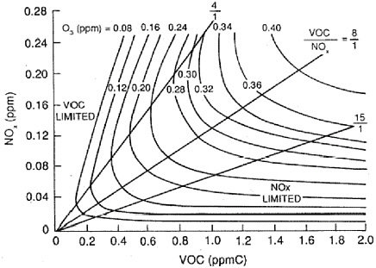
2. Air Pollution Chemistry
Transition regime
We cannot treat VOC and NO_{X} separately!
In the lower right NO_{X}- limited regime (VOC concentration is much higher than NOX), large changes in VOC have little effect on O₃.
In the upper left VOC-limited regime, lowering NO_{X} can actually increase O_{3.}
Question: Which regime is NYC now?
Transform from VOC-limited/transition regime into NOX-limited at around 2000s

Slide 11
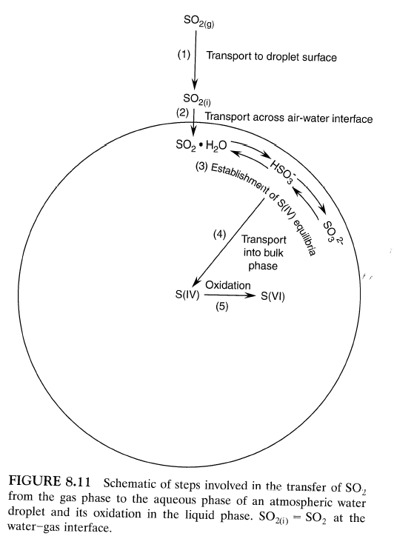
Processes involved for a reactive trace gas to undergo an aqueous oxidation reaction
3. Aqueous Chemistry
Transport (diffusion) of gas to liquid surface.
Transfer of gas across the air-liquid interface. (gas-liquid equilibrium)
Formation of the aqueous phase equilibria of the dissolved species (if applicable).
Transport (diffusion) of the dissolved species into the bulk aqueous phase.
Chemical reactions in the droplet.

Slide 12
Henry’s Law
3. Aqueous Chemistry
Henry’s Law describes the equilibrium absorption of a gas into a liquid (its solubility):
A(g) + H₂O(ℓ) ⇌ A•H₂O
or A(g) ⇌ A(aq)
This is an equilibrium reaction (forward and backward reactions) and we can define an equilibrium constant, in this case called a Henry’s Law coefficient: H_{A}.
The aqueous concentration (A•H₂O or A(aq)) is usually expressed in moles/liter or M; and A(g) in atmospheres (partial pressure), so
H_{A} = [A(aq)]/p_{A} or [A•H₂O]/p_{A}; units M atm⁻¹

Slide 13
3. Aqueous Chemistry
Henry’s Law is often written
[A(aq)] = H_{A}p_{A}
Product conc. reactant concentration
Henry’s Law describes only the physical solubility of the gas and not any chemical changes that may occur after dissolution.
(For gases that hydrolyze and dissociate, we will later define an effective Henry’s Law coefficient H*, which takes the additional dissociated species [i.e. chemical changes] into account.)

Slide 14
3. Aqueous Chemistry
Effective Henry's law coefficient practice
Nitric acid is one of the most water-soluble atmospheric gases with a Henry's law constant
(at 298 K) of H_{HNO3} = 2.1 x 105 M atm⁻¹. After dissolution:
HNO₃(g)⇌HNO₃(aq)
the nitric acid dissociates readily to nitrate:
HNO3(aq) ⇌ ${NO}_{3}^{−}$+ H⁺
The dissociation constant for nitrate is K_{n1} = 15.4 M at 298 K.
The total dissolved nitric acid [${\text{HNO}}_{3}^{T}$ ] will then be [${\text{HNO}}_{3}^{T}$ ] = [HNO3(aq)] + [${NO}_{3}^{−}$ ]
Question:
Derive [${\text{HNO}}_{3}^{T}$ ], as a a function of [H+].
Derive the effective Henry's law coefficient for nitric acid
${\text{H}}_{HNO3}^{∗}$

Slide 15
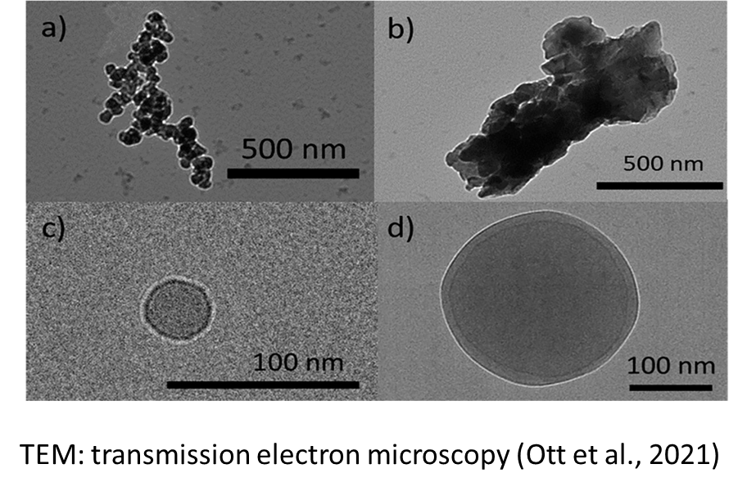
4. Aerosol Chemistry
For ambient aerosol, what do we generally measure?
What do we want from these measurements
Simply assumed to be a sphere
Mass concentration (µg m⁻³)
Aerosol source
number concentration (# m⁻³)
Formation pathway
Size distribution
Aerosol evolution
Chemical compounds
Response to emission control
Other…
Others

Slide 16
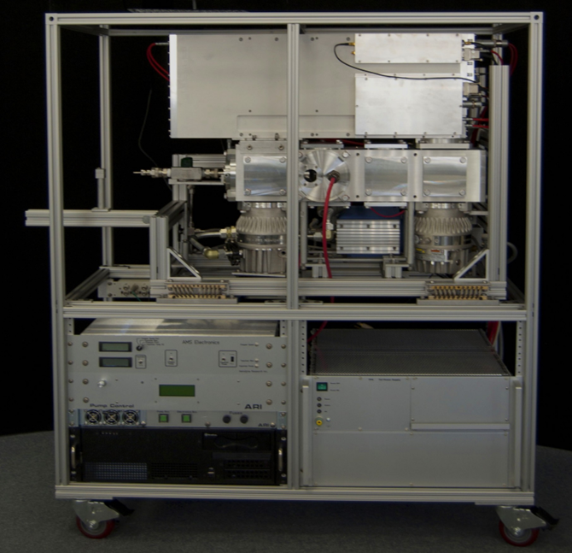
4. Aerosol properties: Chemical Components
Note: AMS has detected size range from around 100nm-1500nm; each instrument has its limitation
OA: Organic
SO4: sulfate
NO3: nitrate
NH4: ammonium
High-Resolution time-of-flight Aerosol Mass Spectrometer (HR-ToF-AMS): measures non-refractory (NR) submicron aerosol (NR-PM1) compositions
Cl: chloride
Others

Slide 17
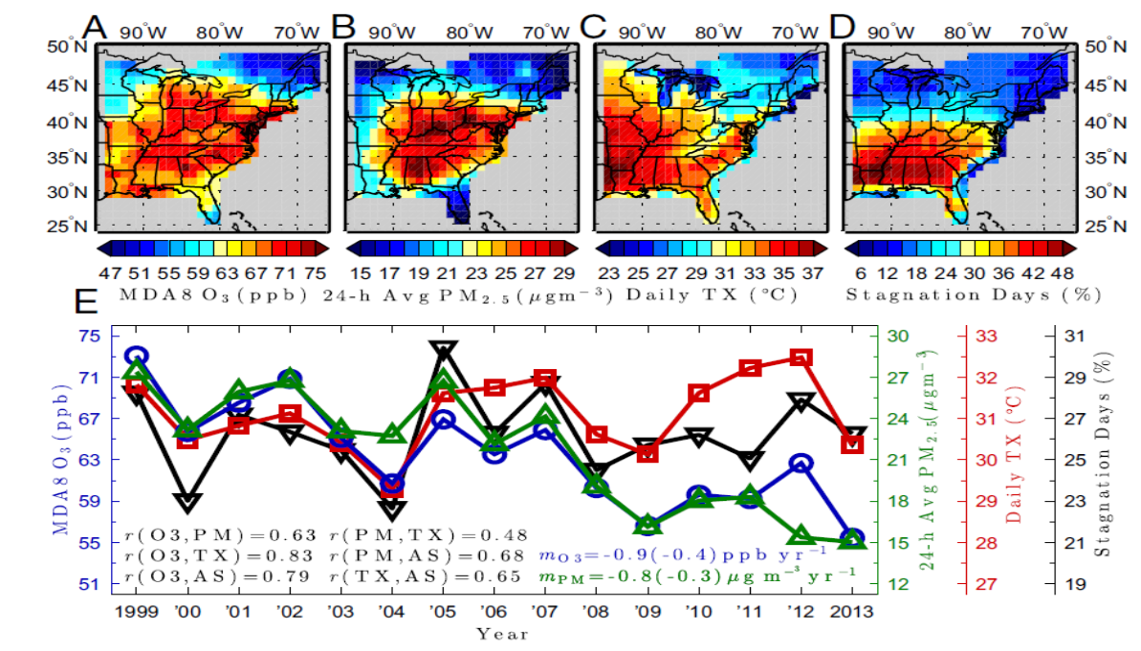
4. Aerosol evolution under heatwave
Persistently high temperature conditions most commonly happen under stagnant conditions with weak surface winds (below 3.2 m s−1) and little or no precipitation (below 1 mm).
Stagnant conditions, in conjunction with strong solar insolation, lead to
an increased photochemical reaction rate between volatile organic compounds (VOCs) and oxidants like the hydroxyl radical (OH),
increased emissions and
the accumulation of anthropogenic nitrogen oxides (NOx), anthropogenic and biogenic VOC precursors,
Thus, leading to an increased production of O3 and secondary organic aerosol (SOA)
Schnell et al., PNAS, 2017
Co-occurrence of extremes in surface ozone, particulate matter, and temperature over eastern North America, which can synergistically worsen their health impacts beyond the sum of their individual effects.
Any thoughts for the reasons?

Slide 18
Measurements of Gas Phase Species
5. Measurements
Gaseous Criteria Pollutants (things that are specifically regulated by the Clean Air Act) - monitoring
Greenhouse Gases
Volatile Organic Carbon species (VOCs)
Reactive and short lived species (research measurements)

Slide 19
Types of Aerosol Measurements
5. Measurements
Aerosol Mass Concentration (regulated quantity – NAAQS)
Filters (gravimetric)
Continuous (various)
Physical Properties
Number Concentration
Size Distribution
Shape
Optical properties –scattering and absorption (index of refraction)
Chemical Composition
Filters (various)
Continuous (various)

